Slide 1
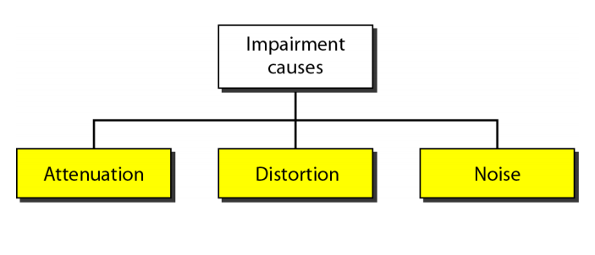
TRANSMISSION IMPAIRMENT
Signals travel through transmission media, which are not perfect.
The imperfection causes signal impairment.
This means that the signal at the beginning of the medium is not the same as the signal at the end of the medium.
What is sent is not what is received.
Notes:
1. Transmission impairment is the degradation of a signal as it travels through a transmission medium

Slide 2
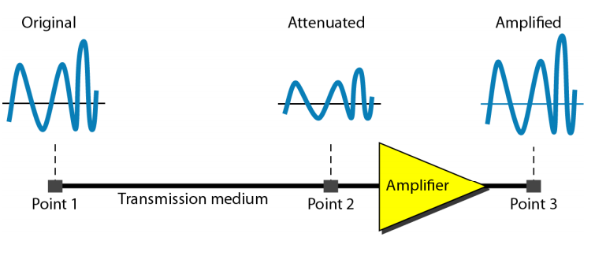
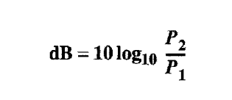
Attenuation
P1 and P2 are power of signal at different points

Slide 3
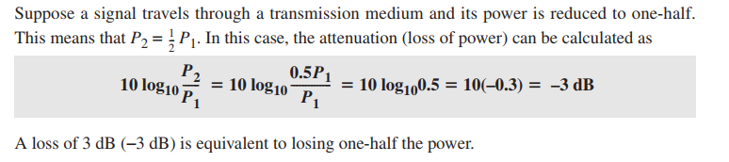
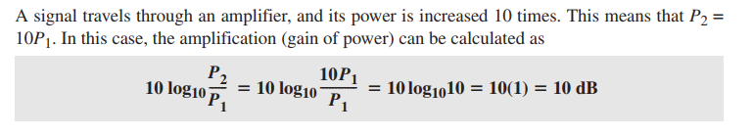

Slide 4
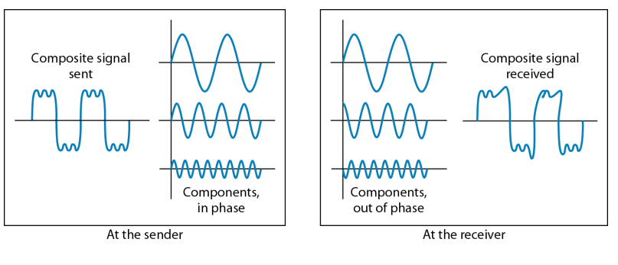
Distortion

Slide 5
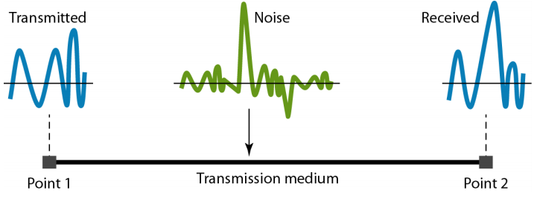
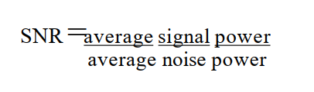
Noise

Slide 6
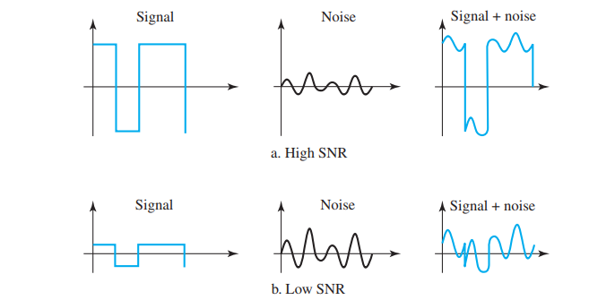

Slide 7
Data Rate
Data rate depends on 3 factors:
The bandwidth available
The level of signals we use
The quality of the channel (the level of noise)
Two theoretical formulas were developed to calculate the data rate
One by Nyquist for noiseless channel
Another by Shannon for a noisy channel

Slide 8

Noiseless channel: Nyquist Bit rate
For a noiseless channel, the Nyquist bit rate formula defines the theoretical maximum bit rate
Bandwidth – Bandwidth of the channel
L – No. of signal levels used to represent data
Bit rate – Bit rate in bits per second
Increasing the level of signal may reduce the reliability of the system

Slide 9
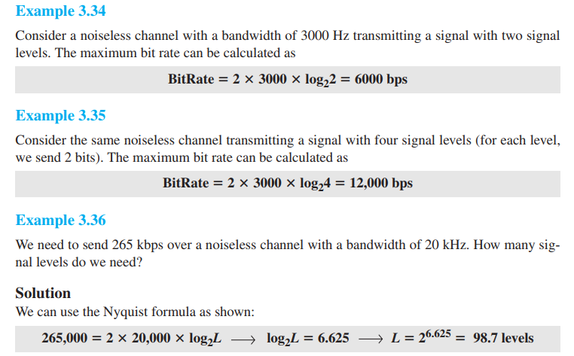

Slide 10

Noisy channel: Shannon Capacity
In reality, we cannot have noiseless channel
To determine the theoretical highest rate for noisy channel
Bandwidth – Bandwidth of channel
SNR – Signal to noise ratio
Capacity – capacity of channel in BPS

Slide 11
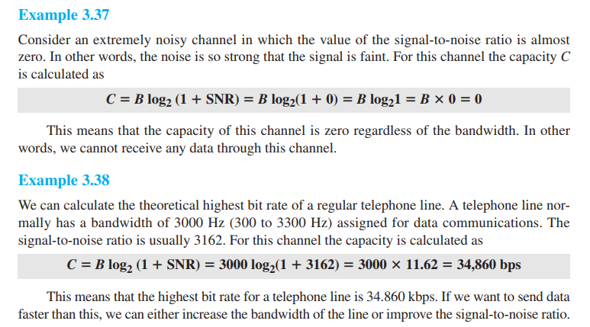

Slide 12
Performance
One important issue in networking is the performance of the network—how good is it? quality of service, an overall measurement of network performance.
Bandwidth - capacity of the system
Bandwidth in Hz
Bandwidth in BPS
Throughput – How fast data can be send through a network
Latency (Delay) – How long data take for an entire message to
completely arrive at the destination from source
Latency = PT + TT + QT + PD

Slide 13
In networking, the term bandwidth is used in two contexts.
The first, bandwidth in hertz, refers to the range of frequencies in a composite signal or the range of frequencies that a channel can pass.
The second, bandwidth in bits per second, refers to the speed of bit transmission in a channel or link. Often referred to as Capacity.
Propagation speed - speed at which a bit travels though the medium from source to destination.
Transmission speed - the speed at which all the bits in a message arrive at the destination. (difference in arrival time of first and last bit)

